Slide 1
Timed Automata
Course: CS60030
FORMAL SYSTEMS
Pallab Dasgupta, Professor,
Dept. of Computer Sc & Engg
Antonio Bruto da Costa, Research Scholar,
Dept. of Computer Sc & Engg

Slide 2
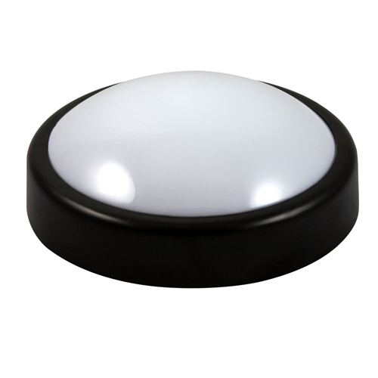
Simple Light Control
Press
Off
Press
Light
Press
Bright
Press
WANT: if press is issued twice quickly
then the light will get brighter; otherwise the light is turned off.
Some of these slides are adapted from Prof. Rajeev Alur’s presentations

Slide 3
Simple Light Control
Press
x:=0
x<=3
Off
Press
Light
Press
Bright
x>3
Press
Solution: Add a real-valued clock x
Adding continuous variables to state machines

Slide 4
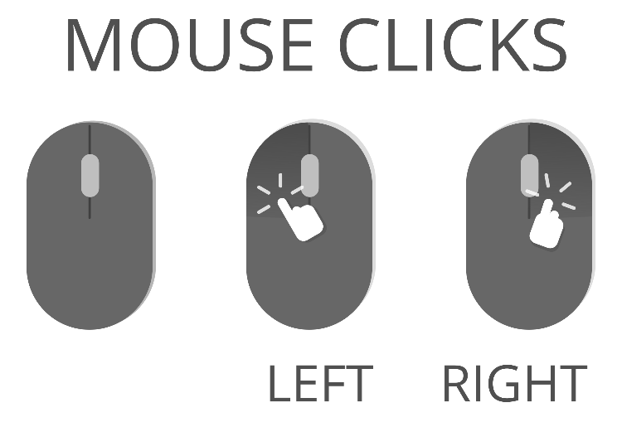
Mouse Clicks
DoubleClick!
Off
Press?
Single Press
Press?
Double
Press
Inputs : a?
Outputs : b!
SingleClick!
WANT: if press is issued twice quickly
then double click; otherwise single click.

Slide 5
Mouse Clicks
x==0
DoubleClick!
x:=0
x:=0
Off
Press?
Single Press
Press?
Double
Press
x<=0.5
x>0.5
SingleClick!
Solution: Add a real-valued clock x
Adding continuous variables to state machines

Slide 6
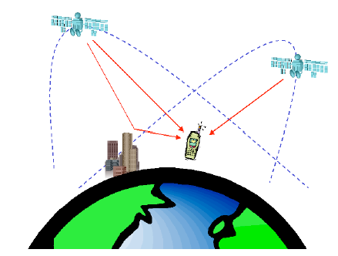



Model Checking
Does
?
SYSTEM
satisfy
SPECIFICATION
start
$$⊨$$
$$φ$$
?
model
model-checker
formula

Slide 7
Systems and Automata
Systems under analysis are modeled and represented as transition systems:
Finite automata
Pushdown automata
Program graphs
Timed automata
Hybrid automata
Petri Nets
Channel Systems
Message Sequence Charts
…

Slide 8
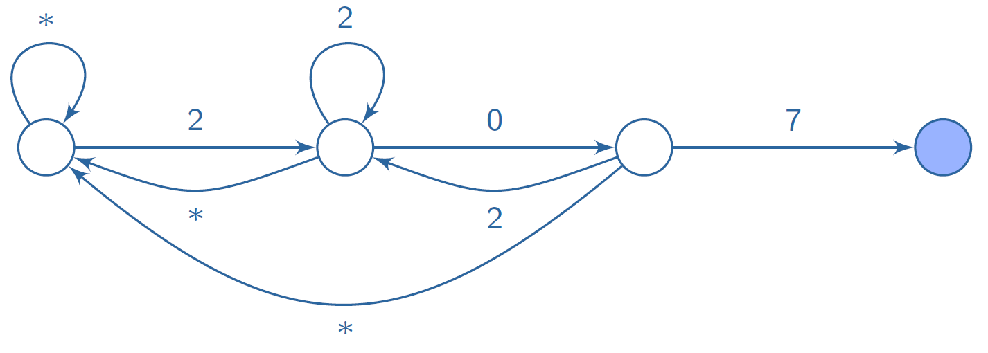
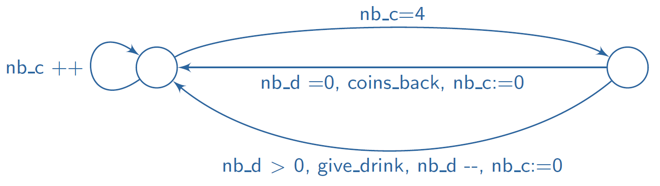
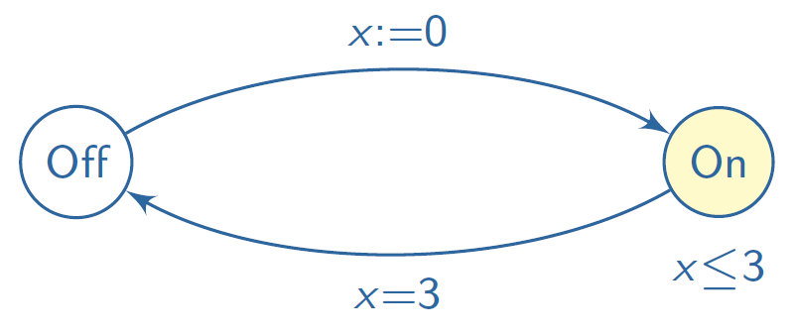
Examples of Models
A numerical code door lock:
A vending machine:
A timed - switch:

Slide 9
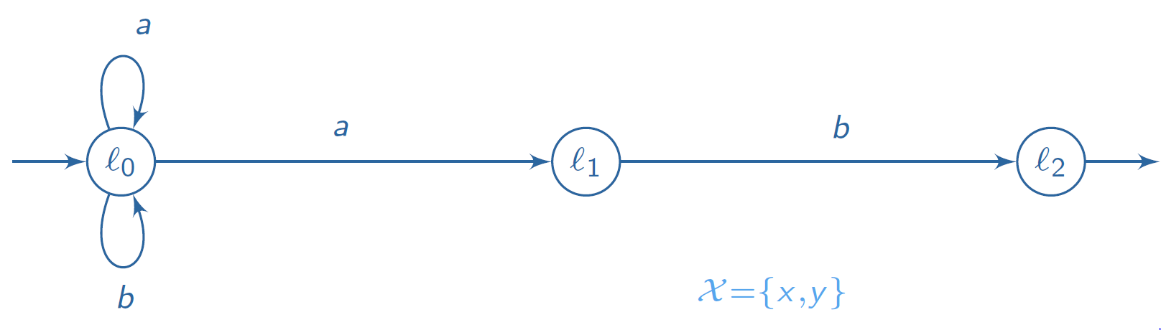
Timed Automata - informally
Timed automaton: Finite automaton enriched with clocks

Slide 10
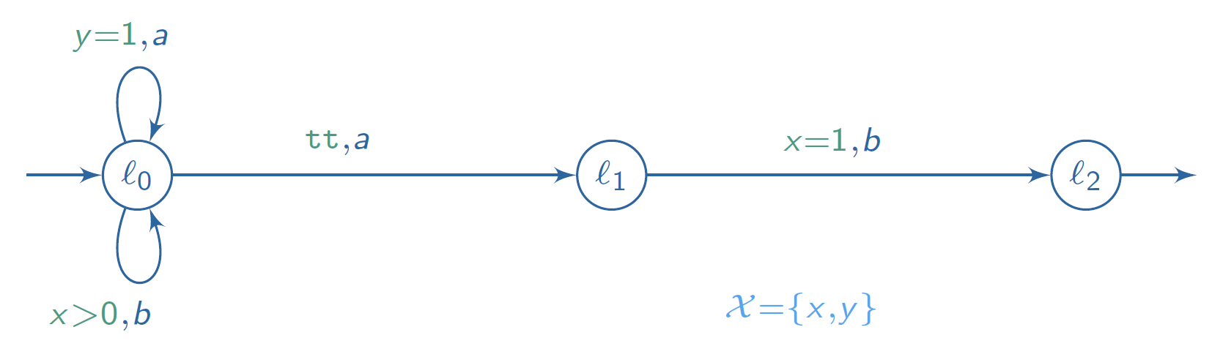
Timed Automata - informally
Timed automaton: Finite automaton enriched with clocks
Transitions: equipped with guards

Slide 11
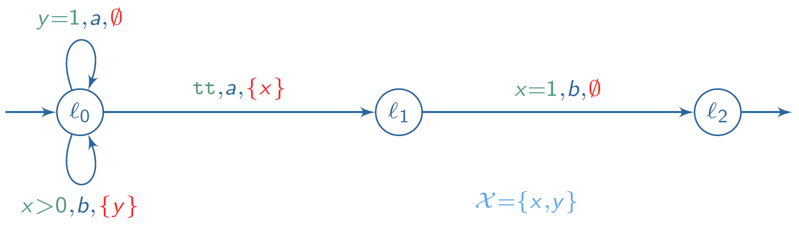
Timed Automata - informally
Timed automaton: Finite automaton enriched with clocks
Transitions: equipped with guards and sets of reset clocks

Slide 12
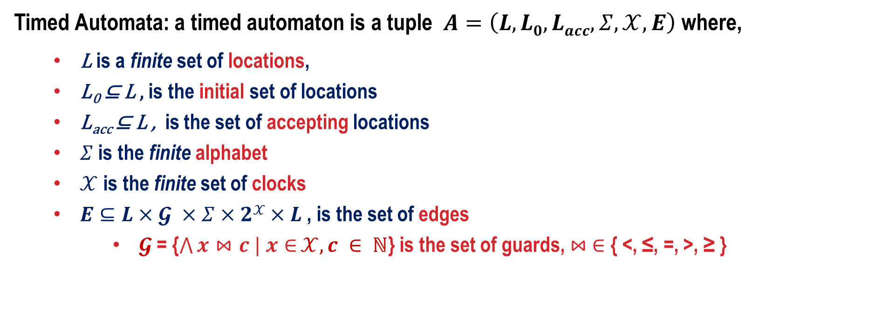
Timed Automaton - Model Structure
Timed Automata: a timed automaton is a tuple $A=\left(L,L0,Lacc,Σ,𝒳,E\right)$ where,
L is a finite set of locations,
L₀ ⊆ L , is the initial set of locations
L_{acc} ⊆ L , is the set of accepting locations
$Σ$ is the finite alphabet
$𝒳$ is the finite set of clocks
$E⊆L×𝓖 ×Σ×2𝒳×L$ , is the set of edges
$𝓖$ = {$\bigwedge{x⋈c | x∈}𝒳, c ∈ ℕ$} is the set of guards, $⋈$ $∈$ { <, ≤, =, >, ≥ }

Slide 13
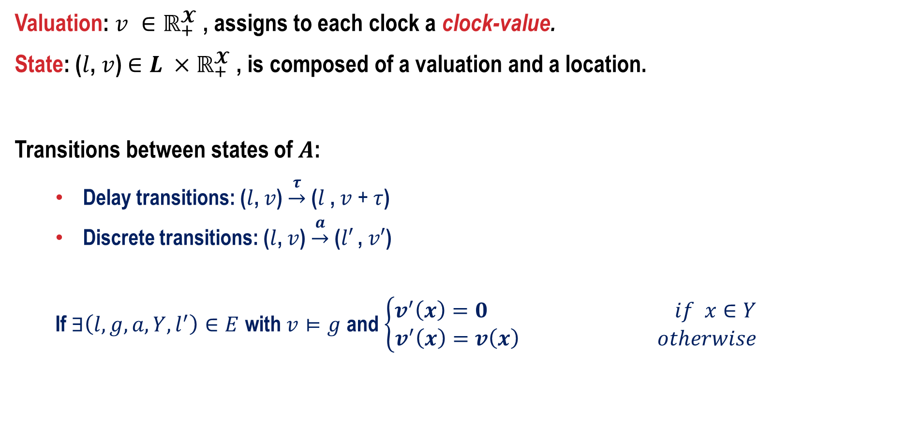
Timed Automaton - Semantics
Valuation: $v ∈ℝ_{+}^{𝓧}$ , assigns to each clock a clock-value.
State: ($l$, $v$) $∈L ×ℝ_{+}^{𝓧}$ , is composed of a valuation and a location.
Transitions between states of $A$:
Delay transitions: ($l$, $v$) $\underset{→}{τ}$ ($l$ , $v$ + $τ$)
Discrete transitions: ($l$, $v$) $\underset{→}{a}$ ($l′$ , $v′$)
If $∃\left(l,g,a,Y,l^{′}\right)∈E$ with $v⊨g$ and $\left\{\begin{aligned}v^{′}\left(x\right)=0 if x∈Y \\ v^{′}\left(x\right)=v\left(x\right) otherwise\end{aligned}\right.$

Slide 14
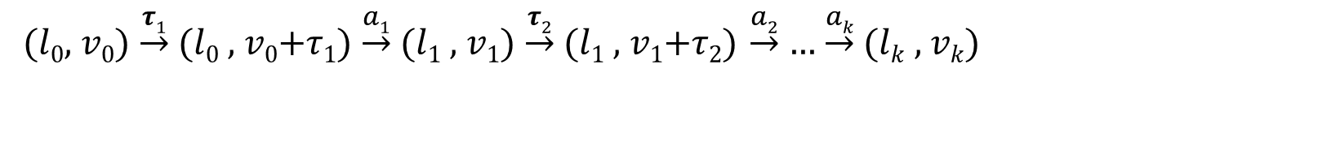
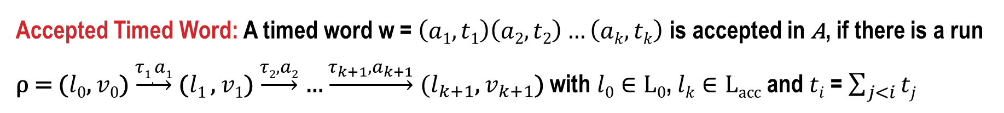
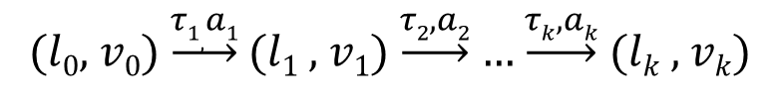
Runs, Sequences, Words, Languages
($l0$, $v0$) $\underset{→}{τ1}$ ($l0$ , $v0$+$τ1$) $\underset{→}{a1}$ ($l1$ , $v1$) $\underset{→}{τ2}$ ($l1$ , $v1$+$τ2$) $\underset{→}{a2}$ … $\underset{→}{ak}$ ($lk$ , $vk$)
Run of A:
or simply
($l0$, $v0$) $\underset{→}{τ1,a1}$ ($l1$ , $v1$) $\underset{→}{τ2,a2}$ … $\underset{→}{τk,ak}$ ($lk$ , $vk$)
Time Sequence: t = $t={\left(ti\right)}_{1≤i≤k}$ is a finite non-decreasing sequence over $ℝ_{+}$.
Timed Word: w = $(\text{σ},t)={\left(ai,ti\right)}_{1≤i≤k}$ where $ai∈Σ$ and $t$ is a time sequence.
Accepted Timed Word: A timed word w = $\left(a1,t1\right)\left(a2,t2\right)…\left(ak,tk\right)$ is accepted in A, if there is a run ρ = ($l0$, $v0$) $\underset{→}{τ1,a1}$ ($l1$ , $v1$) $\underset{→}{τ2,a2}$ … $\underset{→}{τ_{k+1},a_{k+1}}$ ($l_{k+1}$, $v_{k+1}$) with $l0∈L0$, $lk∈Lacc$ and $ti$ = $\sum_{j<i}{tj}$
Accepted timed language: $𝓛$(A) = $\left\{w \right| w accepted by A\}$

Slide 15
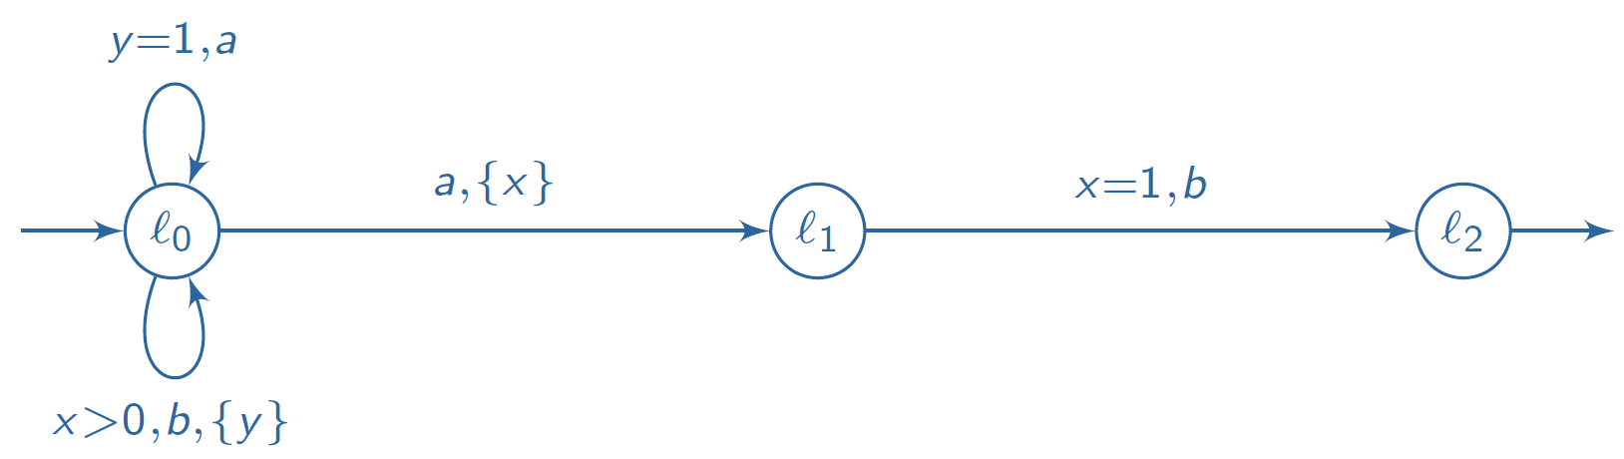
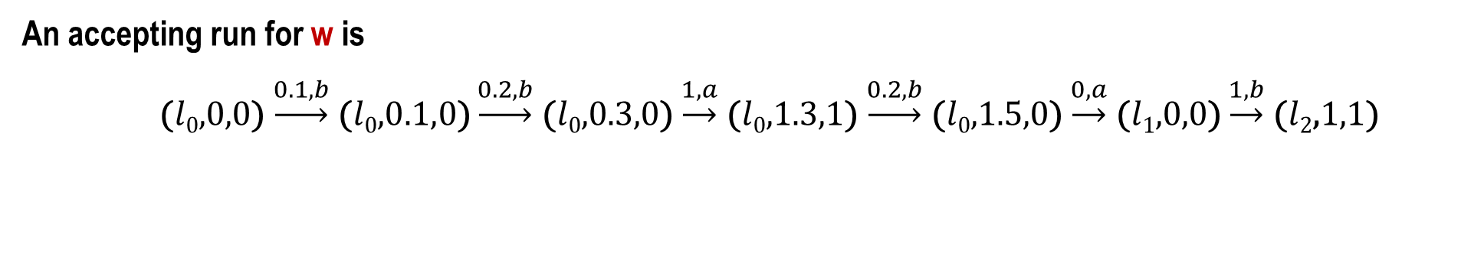
An Example
We omit:
Guards when they are identity
Reset set when empty
w = (b, 0.1)(b, 0.3)(a, 1.3)(b, 1.5)(a, 1.5)(b, 2.5) is an accepted timed word
An accepting run for w is
($l0$,0,0) $\underset{→}{0.1,b}$ ($l0$,$0.1,0$) $\underset{→}{0.2,b}$ ($l0$,0.3,0) $\underset{→}{1,a}$ ($l0$,1.3,1) $\underset{→}{0.2,b}$ ($l0$,1.5,0) $\underset{→}{0,a}$ ($l1$,0,$0$) $\underset{→}{1,b}$ ($l2$,1,1)

Slide 16
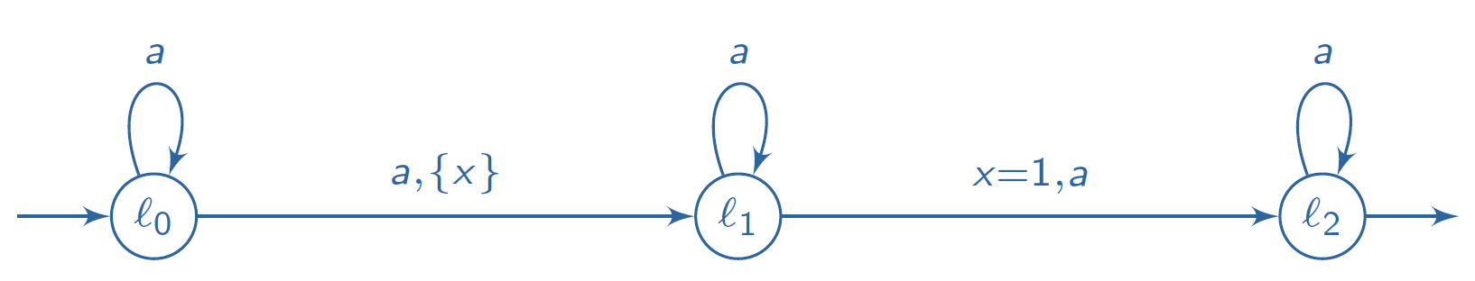
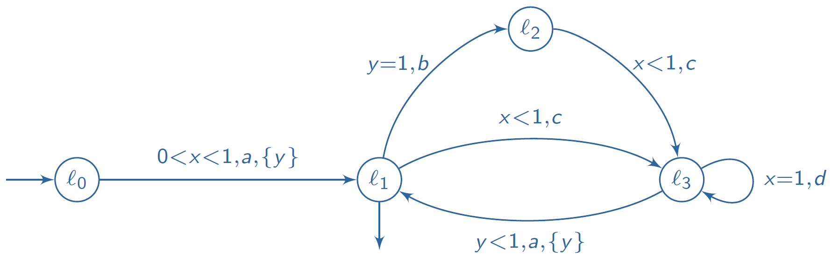
More Examples
$𝓛$(A) = $\left\{\left(a,t1\right)\left(a,t2\right),…,\left(a,tk\right)\right| ∃i<j, tj−ti=1\}$
Does there exist an accepted timed word containing action b?

Slide 17
Adding Invariants
(Henzinger et al, 1992)
n
Clocks: x, y
x<=5
Transitions:
x<=5 & y>3
Location
Invariants
wait(3.2)
( n , x=2.4 , y=3.1415 )
a
x := 0
wait(1.1)
( n , x=2.4 , y=3.1415 )
( n , x=3.5 , y=4.2415 )
m
y<=10
g4
g1
g3
Invariants ensure progress!!
g2

Slide 18
Another Example: Model of a small jobshop
Must rest for at
least 5 mins
Cant work for more
than 60 minutes
start
x := 0
y := 0
x ≥ 5
y := 0
Cant rest for more
than 10 mins
x ≤ 10
x ≤ 60
y ≤ 4
Rest
Work
hit
x := 0
y ≥ 1
x ≥ 40
At most one
nail every minute
done
At least one nail
every 4 minutes
Must work for at
least 40 minutes

Slide 19
And one more: Rail Gate Crossing
far
approach
near
up
lower
x >= 1
y <= 1
x <= 5
y := 0
x := 0
exit
enter
y >= 1
x := 0
x > 2
raise
y <= 2
in
y := 0
down
Train
Gate
approach
z := 0
z <= 3
Controller
lower
raise
exit
z <= 1
z := 0

Slide 20
And one more: Rail Gate Crossing
far
approach
near
up
lower
x >= 1
y <= 1
x <= 5
y := 0
x := 0
exit
enter
y >= 1
x := 0
x > 2
raise
y <= 2
in
y := 0
down
Train
Gate
approach
z := 0
z <= 3
Controller
lower
raise
exit
z <= 1
z := 0
time

Slide 21
And one more: Rail Gate Crossing
far
approach
near
up
lower
x >= 1
y <= 1
x <= 5
y := 0
x := 0
exit
enter
y >= 1
x := 0
x > 2
raise
y <= 2
in
y := 0
down
Train
Gate
approach
z := 0
z <= 3
Controller
lower
raise
exit
z <= 1
z := 0
approach
z <= 3
time

Slide 22
And one more: Rail Gate Crossing
far
approach
near
up
lower
x >= 1
y <= 1
x <= 5
y := 0
x := 0
exit
enter
y >= 1
x := 0
x > 2
raise
y <= 2
in
y := 0
down
Train
Gate
approach
z := 0
z <= 3
Controller
lower
raise
exit
z <= 1
z := 0
approach
lower
z <= 3
y <= 1
time

Slide 23
And one more: Rail Gate Crossing
far
approach
near
up
lower
x >= 1
y <= 1
x <= 5
y := 0
x := 0
exit
enter
y >= 1
x := 0
x > 2
raise
y <= 2
in
y := 0
down
Train
Gate
approach
z := 0
z <= 3
Controller
lower
raise
exit
z <= 1
z := 0
x = 2.1
y = 0.9
z = 2.1
approach
lower
enter
x > 2 ∧ x <= 5
time

Slide 24
Time Convergence, Timelocks, Zenoness
Not all paths in a timed automaton represent realistic behaviours.
Examples…
Three essential phenomena:
Time Convergence
Timelock
Zenoness

Slide 25
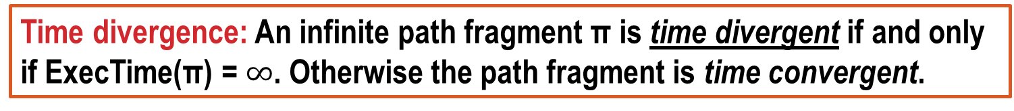
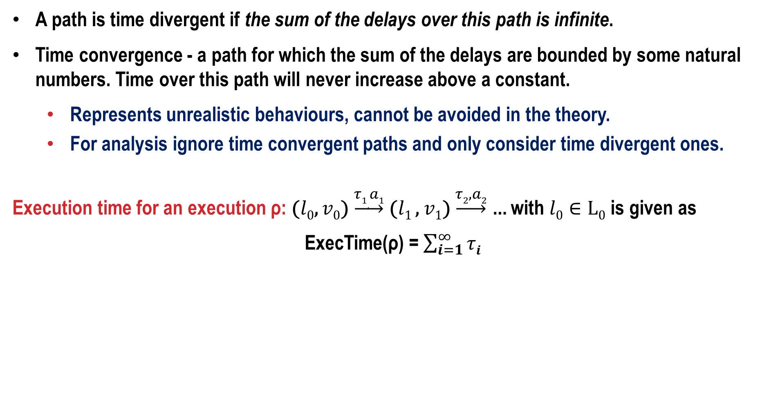
Time Divergence
A path is time divergent if the sum of the delays over this path is infinite.
Time convergence - a path for which the sum of the delays are bounded by some natural numbers. Time over this path will never increase above a constant.
Represents unrealistic behaviours, cannot be avoided in the theory.
For analysis ignore time convergent paths and only consider time divergent ones.
Execution time for an execution ρ: ($l0$, $v0$) $\underset{→}{τ1,a1}$ ($l1$ , $v1$) $\underset{→}{τ2,a2}$ … with $l0∈L0$ is given as
ExecTime(ρ) = $\sum_{i=1}^{∞}{τi}$
Time divergence: An infinite path fragment π is time divergent if and only if ExecTime(π) = $∞$. Otherwise the path fragment is time convergent.

Slide 26
Timelocks
For a state σ in a timed-automaton, there must be some way for time to progress.
If no way is possible, then “σ ” has a timelock.
A timed automaton is timelock-free iff none of its reachable states contains a timelock.
A timelock is a modeling flaw – should be avoided.
Let Paths_{div}(σ) be the set of time-divergent paths starting in σ. A state s contains a timelock iff Paths_{div}(σ) = Φ

Slide 27
Zenoness
An infinite path fragment π is zeno if and only if it is time-convergent and infinitely many discrete actions are executed within π.
Zeno paths represent non-realizable behaviour
since their execution would require infinitely fast processors.
Thus zeno paths are modelling flows and should be avoided.
To check whether a timed automaton is non-zeno is algorithmically difficult.
Instead, sufficient conditions are considered that are simple to check, e.g., by static analysis.

Slide 28
Verification
System modeled as a product of timed automata
Verification problem reduced to reachability or to temporal logic model checking
Applications
Real-time controllers
Asynchronous timed circuits
Scheduling
Distributed timing-based algorithms

Slide 29
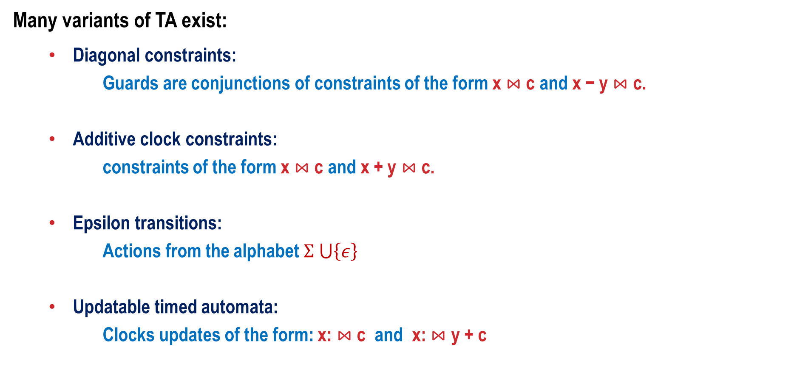
Variants of timed automata
Many variants of TA exist:
Diagonal constraints:
Guards are conjunctions of constraints of the form x $⋈$ c and x − y $⋈$ c.
Additive clock constraints:
constraints of the form x $⋈$ c and x + y $⋈$ c.
Epsilon transitions:
Actions from the alphabet $Σ ⋃\left\{ε\right\}$
Updatable timed automata:
Clocks updates of the form: x: $⋈$ c and x: $⋈$ y + c

Slide 30
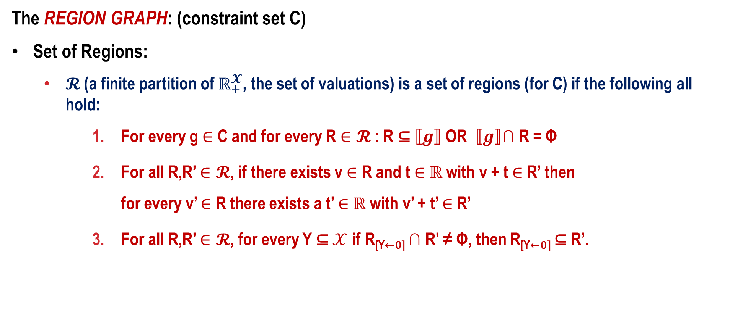
Timed Automata and Reachability Abstractions
The REGION GRAPH: (constraint set C)
Set of Regions:
$𝓡$ (a finite partition of $ℝ_{+}^{𝓧}$, the set of valuations) is a set of regions (for C) if the following all hold:
For every g $∈$ C and for every R $∈𝓡$ : R ⊆ $⟦g⟧$ OR $⟦g⟧$∩ R = Φ
For all R,R’ $∈𝓡$, if there exists v $∈$ R and t $∈$ $ℝ$ with v + t $∈$ R’ then for every v’ $∈$ R there exists a t’ $∈$ $ℝ$ with v’ + t’ $∈$ R’
For all R,R’ $∈𝓡$, for every Y ⊆ $𝒳$ if R_{[Y←0]} ∩ R’ ≠ Φ, then R_{[Y←0]} ⊆ R’.

Slide 31
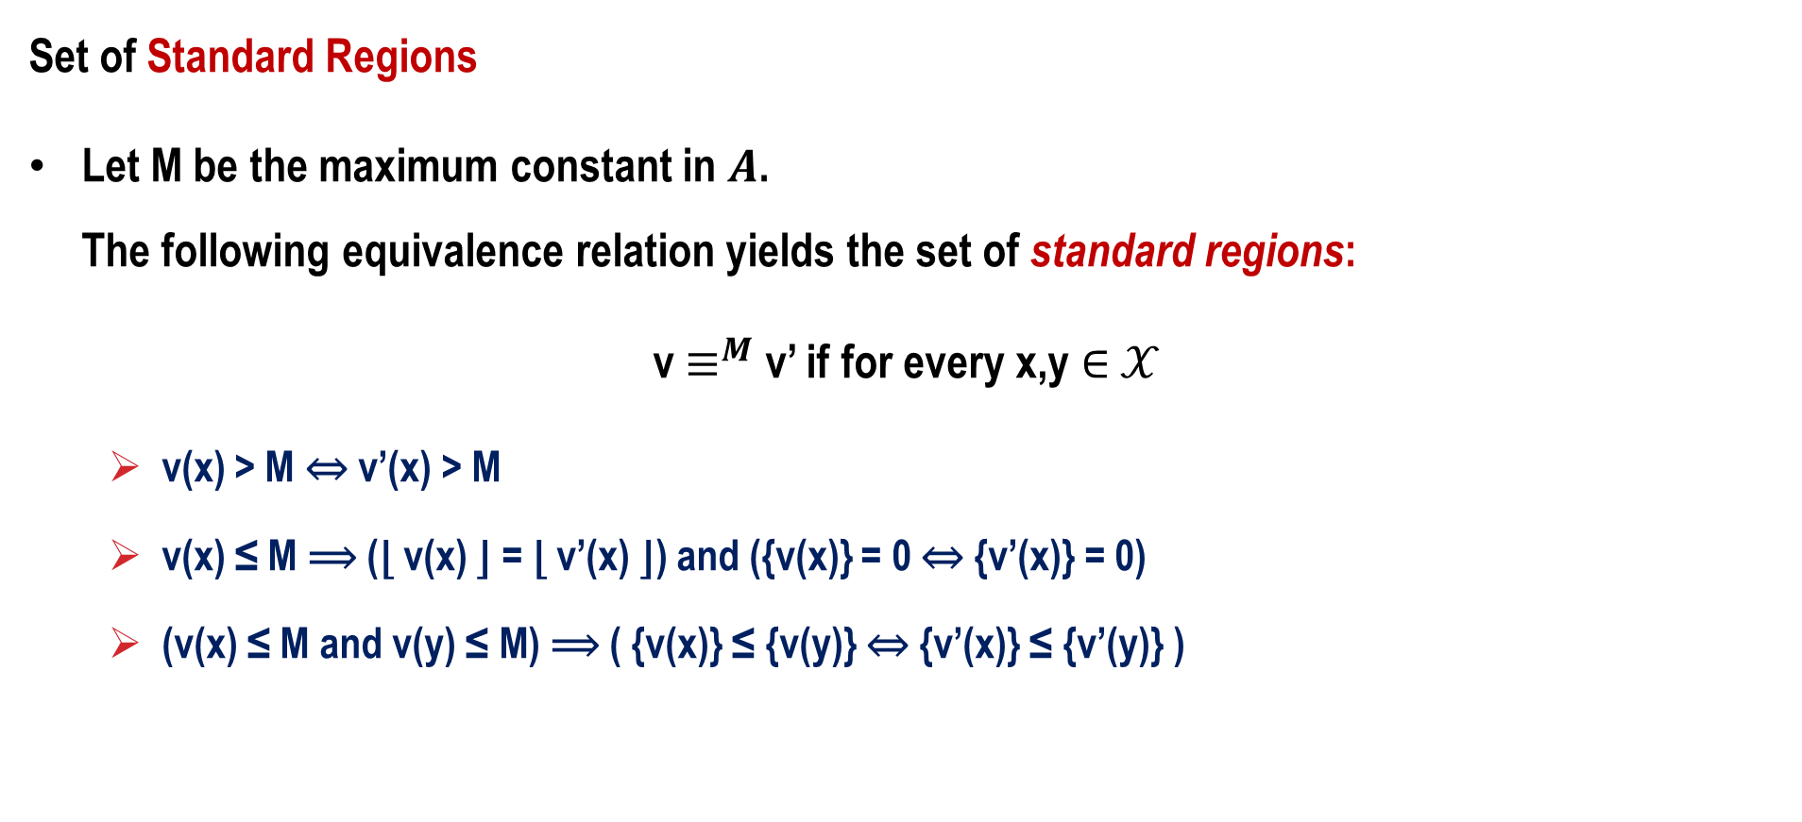
Region Graphs
Set of Standard Regions
Let M be the maximum constant in $A$. The following equivalence relation yields the set of standard regions:
v $≡^{M}$ v’ if for every x,y $∈$ $𝒳$
v(x) > M ⇔ v’(x) > M
v(x) ≤ M ⟹ (⌊ v(x) ⌋ = ⌊ v’(x) ⌋) and ({v(x)} = 0 ⇔ {v’(x)} = 0)
(v(x) ≤ M and v(y) ≤ M) ⟹ ( {v(x)} ≤ {v(y)} ⇔ {v’(x)} ≤ {v’(y)} )

Slide 32
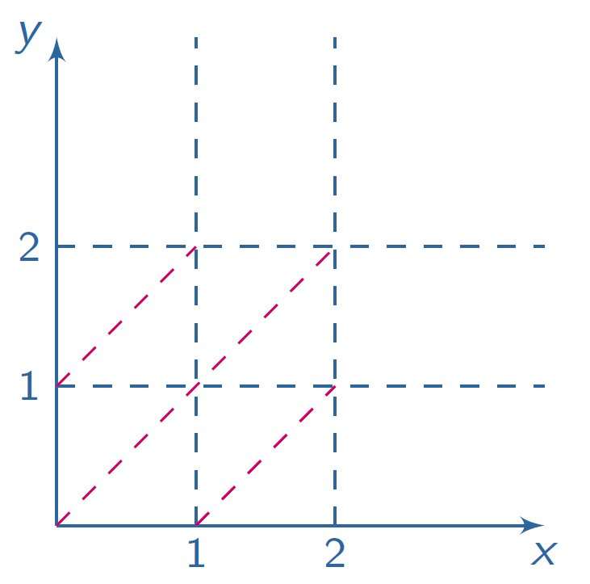
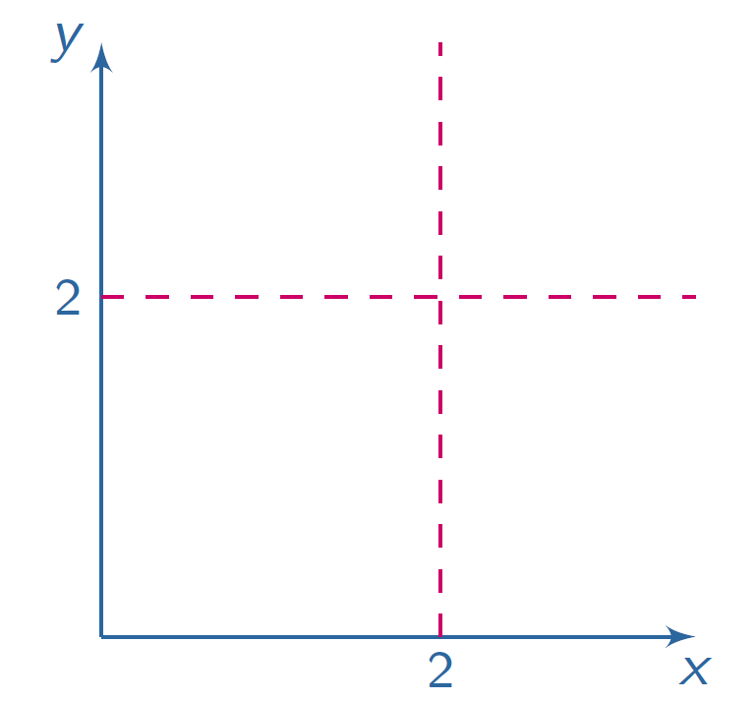
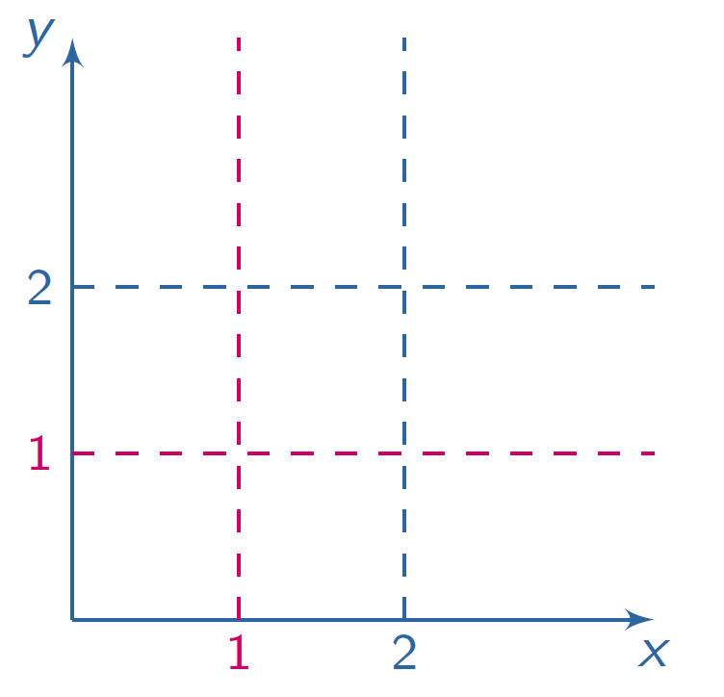
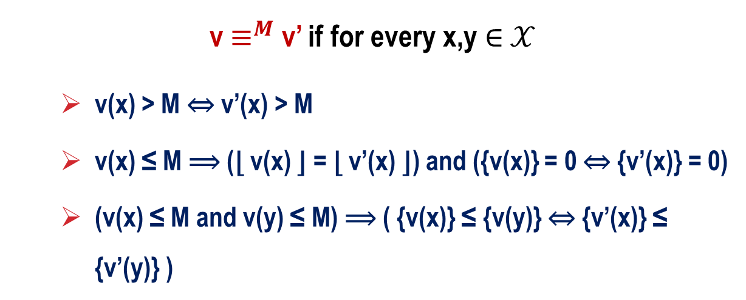
Standard Regions (what do the rules mean?)
2 Clocks = 2 dimensions
The partition is compatible with constraints, time elapsing and resets.
v $≡^{M}$ v’ if for every x,y $∈$ $𝒳$
v(x) > M ⇔ v’(x) > M
v(x) ≤ M ⟹ (⌊ v(x) ⌋ = ⌊ v’(x) ⌋) and ({v(x)} = 0 ⇔ {v’(x)} = 0)
(v(x) ≤ M and v(y) ≤ M) ⟹ ( {v(x)} ≤ {v(y)} ⇔ {v’(x)} ≤ {v’(y)} )

Slide 33

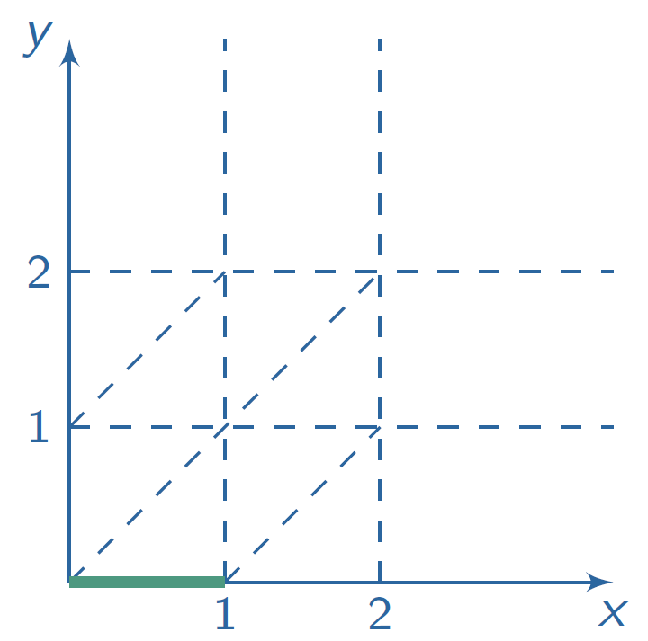
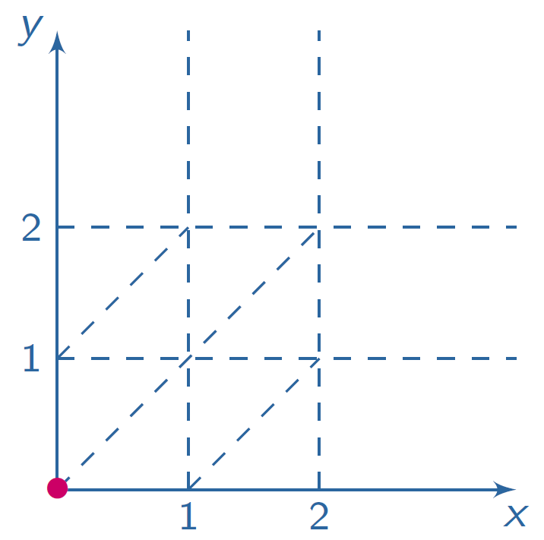
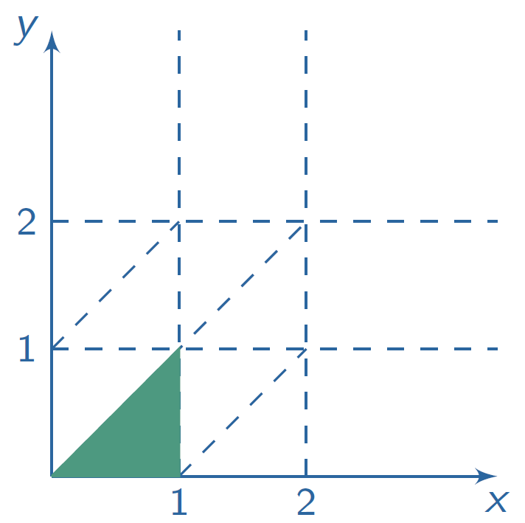
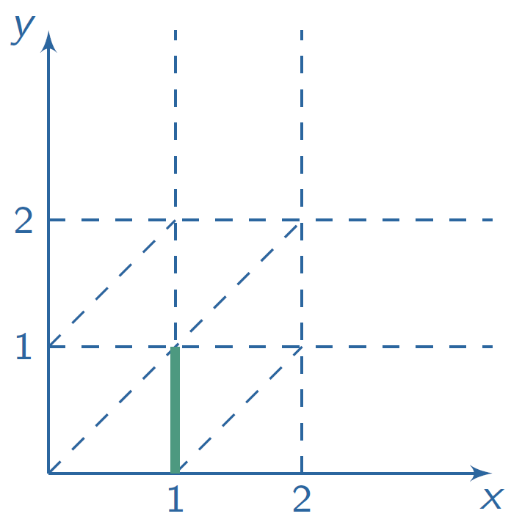
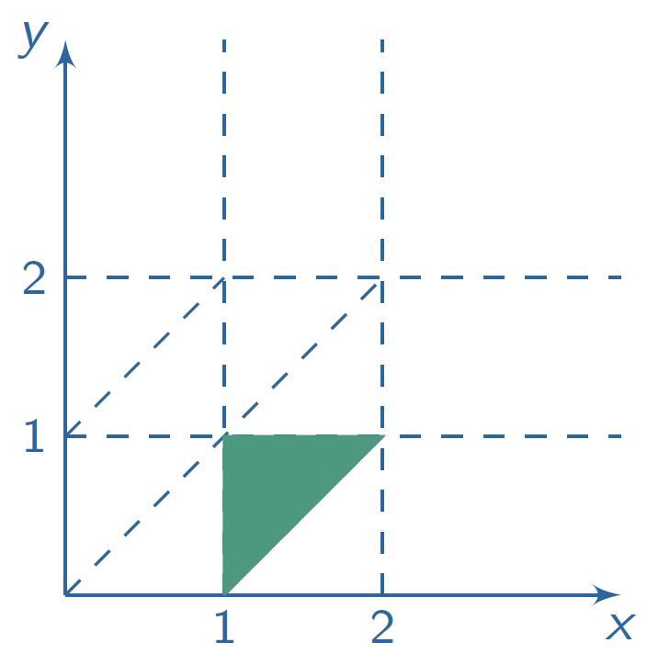
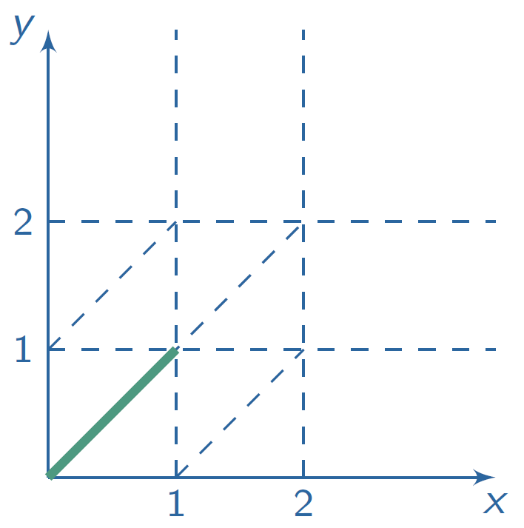
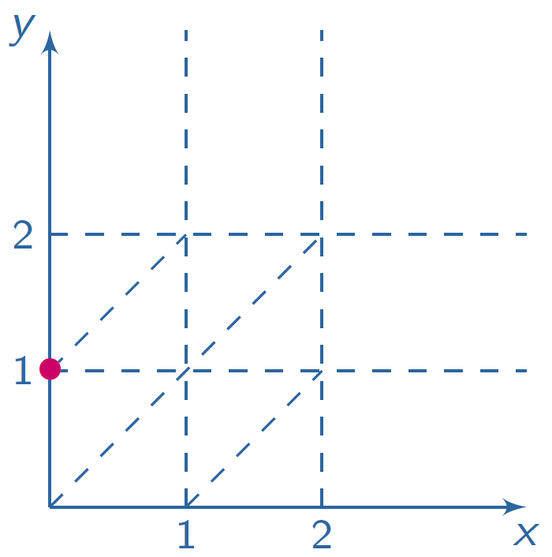
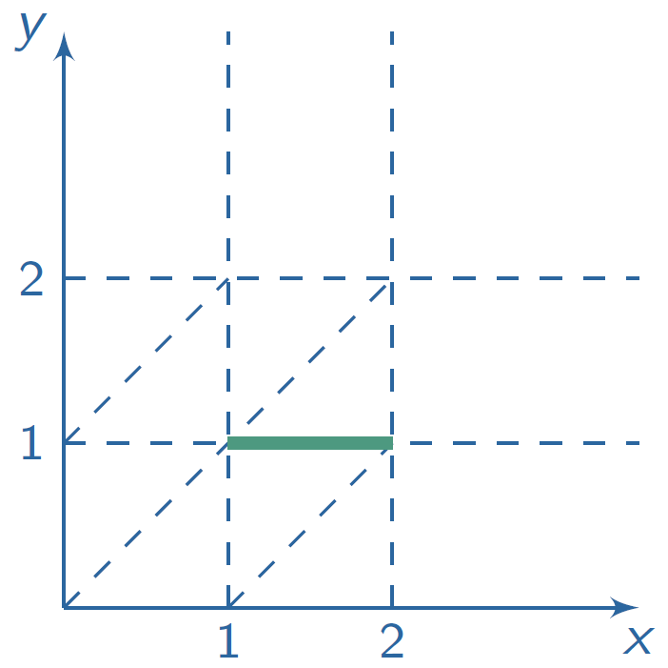




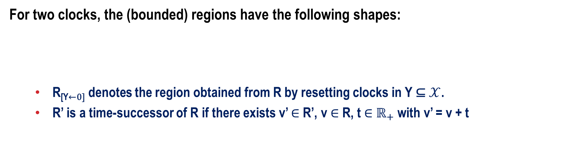



Operations on Regions
For two clocks, the (bounded) regions have the following shapes:
R_{[Y←0]} denotes the region obtained from R by resetting clocks in Y ⊆ $𝒳$.
R’ is a time-successor of R if there exists v’ $∈$R’, v $∈$R, t $∈$ $ℝ_{+}$ with v’ = v + t
(x=0,y=0)
$$\underset{→}{delay}$$
(0<x=y<1)
$$\underset{→}{y≔0}$$
(0<x<1,y=0)
$$\underset{→}{delay}$$
(0<y<x<1)
$$\underset{→}{delay}$$
(0<y<1=x)
$$\underset{→}{delay}$$
(1<x<2,0<y<1,{x}<{y})
$$\underset{→}{delay}$$
(y=1<x<2)
$$\underset{→}{x≔0}$$
(x=0,y=1)

Slide 34
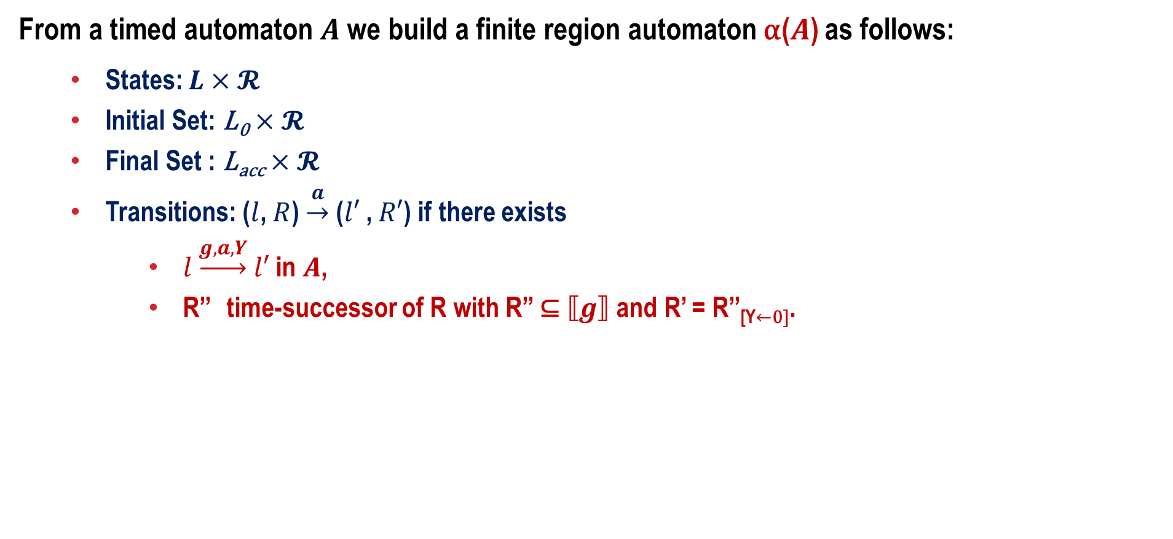
Region Automaton
From a timed automaton $A$ we build a finite region automaton α($A$) as follows:
States: $L×𝓡$
Initial Set: L₀$×𝓡$
Final Set : L_{acc}$×𝓡$
Transitions: ($l$, $R$) $\underset{→}{a}$ ($l′$ , $R′$) if there exists
$l$ $\underset{→}{g,a,Y}$ $l′$ in $A$,
R’’ time-successor of R with R’’ ⊆ $⟦g⟧$ and R’ = R’’_{[Y←0]}.

Slide 35
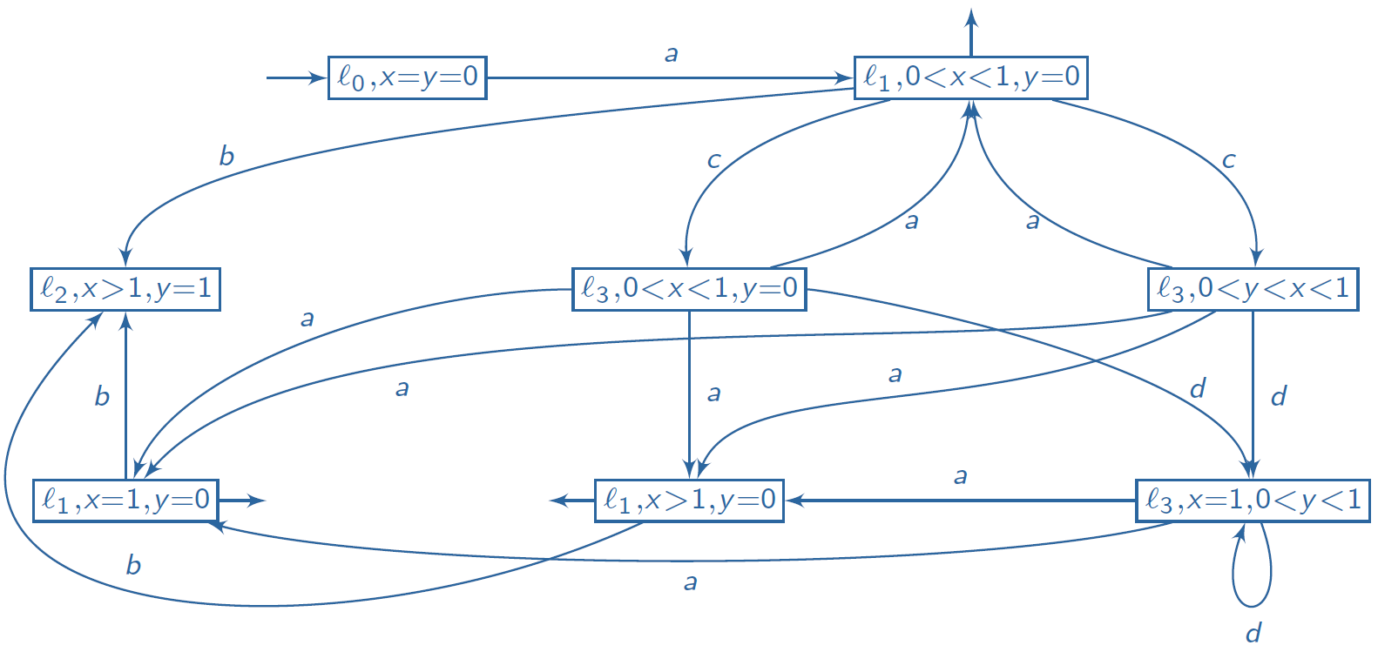
Example
Timed Automaton
Region Automaton

Slide 36
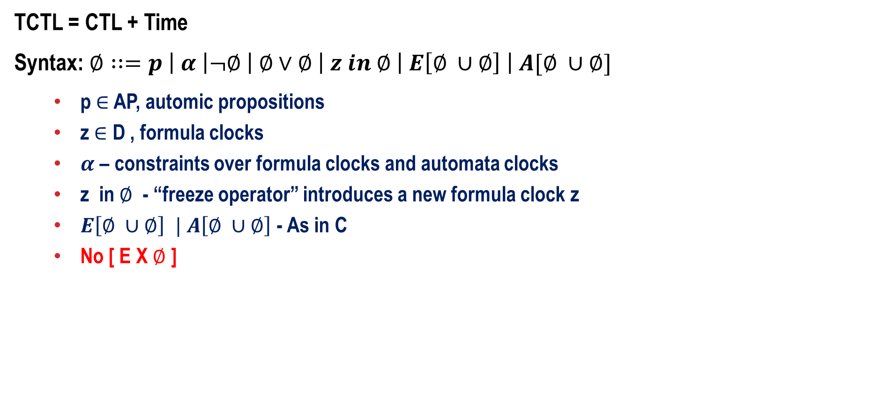
A Logic for Timed Automata – Timed CTL
TCTL = CTL + Time
Syntax: $∅∷=p \left| α \right|¬∅ \left| ∅∨∅ \right| z in ∅ \left| E\left[∅ ∪∅\right] \right| A[∅ ∪∅]$
p $∈$ AP, automic propositions
z $∈$ D , formula clocks
$α$ – constraints over formula clocks and automata clocks
z in $∅$ - “freeze operator” introduces a new formula clock z
$E\left[∅ ∪∅\right] | A\left[∅ ∪∅\right]$ - As in C
No [ E X $∅$ ]

Slide 37


Derived Operators
A [$∅$ U_{≤7} ψ]
= z in A [($∅$ ⋀ z ≤7) U ψ]
Along any path, $∅$ hold continuously until within 7 time units ψ becomes valid.
E F_{≤5} $∅$]
= z in EF [( z < 5) ⋀ $∅$]
There is a path on which the property $∅$ becomes valid within 5 time units.

Slide 38
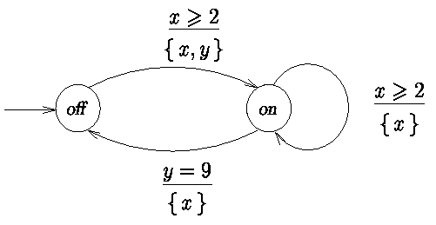
Consider the Light Switch

Slide 39
Timeliness Properties
AG [send(m) ⟹ AF_{<5} receive(m)]
receive(m) always occurs within 5 time units after send(m)
EG [send(m) ⟹ AF₌₁₁ receive(m)]
receive(m) may occur exactly 11 time units after send(m)
AG [ AG₌₂₅ putbox]
putbox occurs periodically (exactly) every 25 time units
(note: other putbox’s may occur in between)

Slide 40
Moving forward from Timed Automata
Regular - Finite (Deterministic/NonDeterministic Finite Automata)
Locations = States, Memory is finite – states are finite.
Discrete actions only
Transition Systems
Finite location systems : possibly infinite states (with variables)
Discrete actions only
Timed Automata
Finite location systems – timers : possibly infinite states (When would a TA have finite states?)
Discrete and Delay actions
Hybrid Automata
Finite location systems – beyond timers : possibly infinite states
Discrete actions and Custom activities

